Slide 1
2020 Living to 100 Symposium
LEONID A. Gavrilov
Session 5A, Multi Population Mortality Modeling
Date: January 14, 2020

Slide 2
5A: Multi Population Mortality Modeling - Discussion
Calibrating Mortality Processes with Trend Changes to Multi-Population Data
Matthias Börger; Justin Schoenfeld; Johannes Schupp
Ulm University

Slide 3
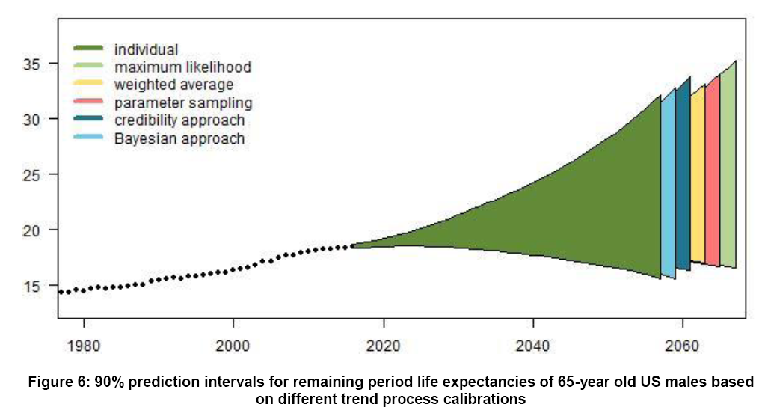
Major Challenge:
Very high uncertainty of life expectancy projections

Slide 4
Possible Solution to Improve Accuracy of Projections (1)
To take into account that rates of mortality change over time are different for different ages

Slide 5
For example, recent scientific publications suggest that human longevity records stopped increasing.
Our finding that the mortality of U.S. centenarians has not decreased noticeably in recent decades is consistent with this suggestion.

Slide 6
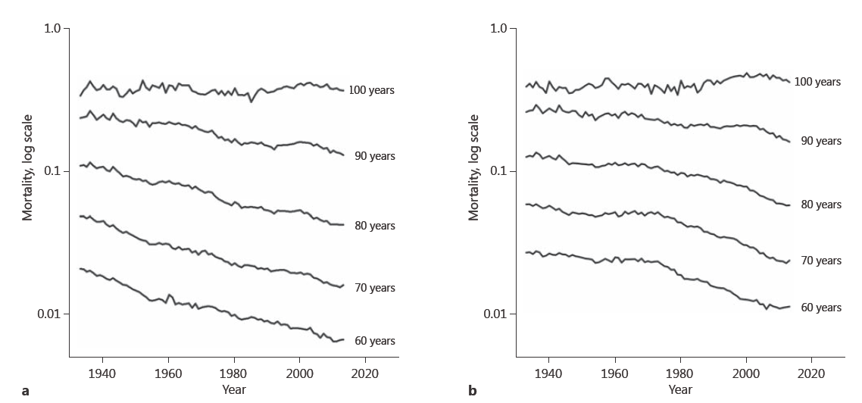
Mortality of U.S. centenarians does not decline over time
Women
Men
Source: Gavrilov et al., Gerontology, 2017

Slide 7
Mortality of U.S. men and women in earlier (1881) and later (1898) birth cohorts Mortality deceleration is observed in early birth cohort only
Женщины
Мужчины
Women
Men
Source: Gavrilov, Gavrilova, Gerontology, 2019. Source of data: Human Mortality Database

Slide 8
Possible Solution to Improve Accuracy of Projections (2)
To eliminate from analyses old data for periods preceding the 1950s when mortality decline followed additive rather than multiplicative model

Slide 9
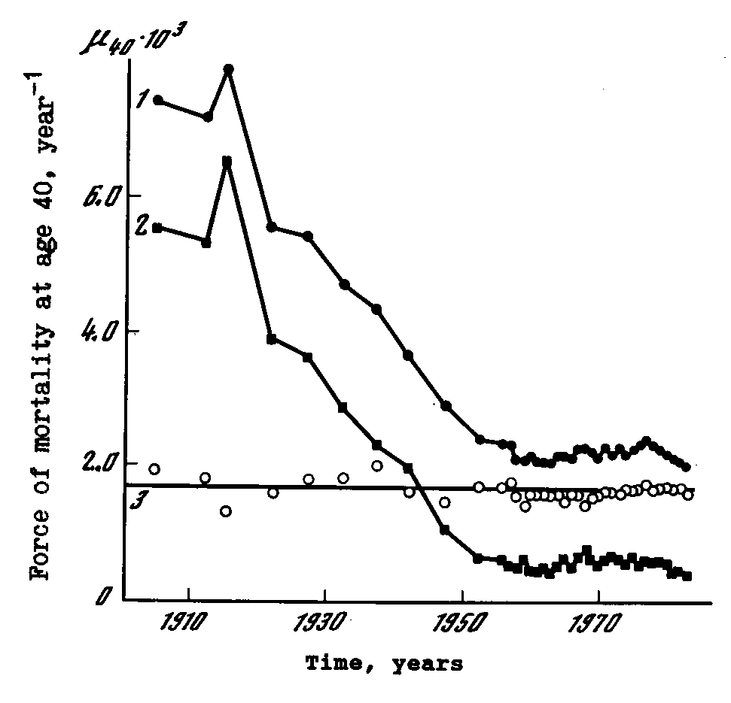
Historical changes of background (Makeham term) and senescent (Gompertzian) mortality of Swedish males.
1 – total (observed) mortality at age 40
2 – background mortality (Makeham parameter)
3 – senescent mortality at age 40 calculated on the basis of Gompertz-Makeham formula
Senescent mortality is shown at age 40
Source: Gavrilov, Gavrilova, Nosov, Gerontology, 1983

Slide 10
Factor Analysis of Mortality
Data for Swedish men and women
Men
Women
Source: Gavrilov, Gavrilova, Presented at the Living to 100 - 2017 Symposium

Slide 11
5A: Multi Population Mortality Modeling - Discussion
The Mathematical Mechanism of Biological Aging
Boquan Cheng, Bruce Jones, FSA, FCIA, Ph.D.,
Xiaoming Liu and Jiandong Ren
University of Western Ontario

Slide 12
This model uses two major assumptions
Transition rates (λ) are equal for all states of organism’s aging.

Slide 13
What is the rationale for this assumption?
Alternative avalanche-like model uses rates of transition, which are increasing with each stage of aging.

Slide 14
Avalanche-like Mechanism of Organism’s Destruction with Age
In the initial state (S₀) organism has no defects. Then, as a result of random damage, it enters states S₁, S₂, …S_{n} where n corresponds to the number of defects. Rate of new defects has avalanche-like growth with the number of already accumulated defects (horizontal arrows). Hazard rate (vertical arrows directed down) also has avalanche-like growth with number of defects.
Source: Gavrilov, Gavrilova, “The Biology of Life Span” 1991

Slide 15
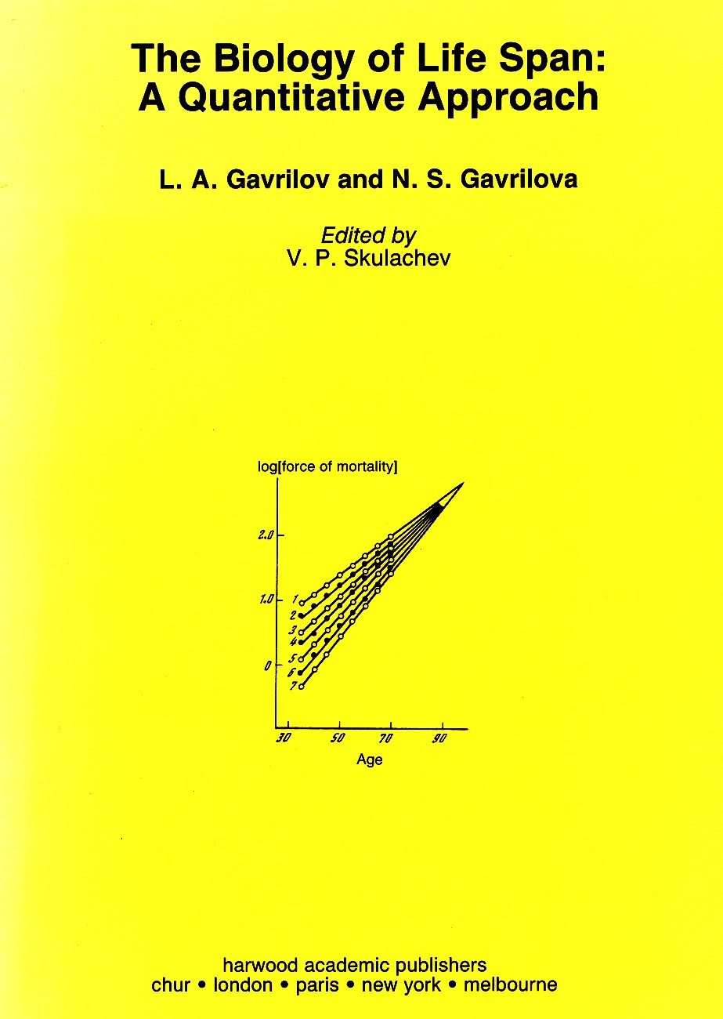
Avalanche-like model for human aging was published in 1991

Slide 16
Second assumption:
There are approximately 100 or 200-250 stages of organism’s aging.

Slide 17
What is the rationale to use this relatively small number of stages for aging?
Alternative avalanche-like model uses unlimited number of stages that allows us to obtain analytical solution for mortality in closed form.
100-250 stages of aging appears to be very small number taking into account huge number of cells in human organism.

Slide 18
Overall, these are two very good papers!

