Slide 1
Fifty Years of Research on the Gompertz Law:
Key Insights and Lessons Learned
Gompertz 200. Celebrating Two Centuries of Longevity Research
Dr. Natalia S. Gavrilova, Ph.D.
Dr. Leonid A. Gavrilov, Ph.D.
NORC at The University of Chicago
Chicago, Illinois, USA

Slide 2
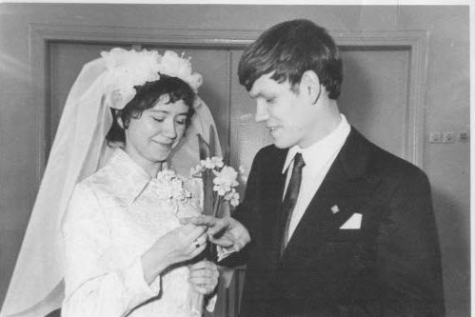
Our brief self-introduction
This year marks the 50th anniversary of our scientific union
We met as students at the Moscow State University (Chemistry department), Russia, and found a common interest in understanding the mechanisms of human aging, with a hope to find ways for extending healthy life.
We were inspired by the scientific approach of Nobel laureate Nikolay Semyonov, who demonstrated that the mechanisms of chemical reactions can be studied through the clever quantitative analysis of reaction kinetics over time.
We decided to apply this approach to studies of aging and mortality by quantitative analysis of mortality kinetics (mortality laws). And the Gompertz law was the most important mortality law.
Moscow, March 14 ,1975

Slide 3
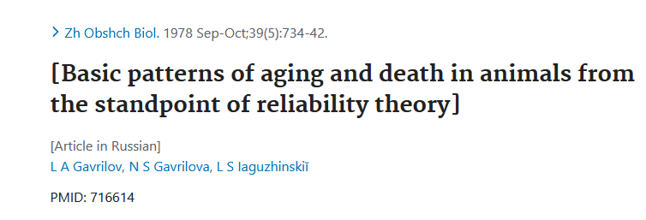
Our first publication in Journal of General Biology (1978) on reliability model explaining three empirical mortality laws

Slide 4
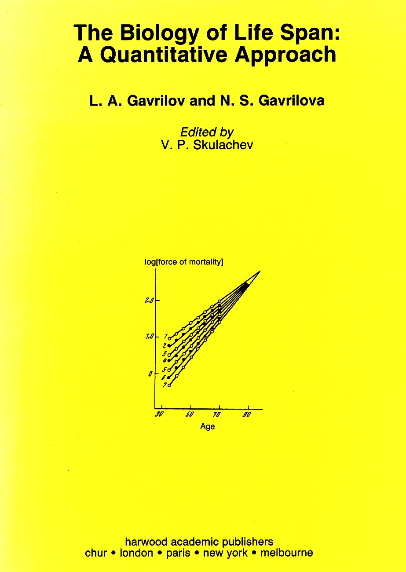
This book published in 1991 summarized our earlier studies of the Gompertz law

Slide 5
The Gompertz Law
Risk of death increases exponentially with age.
μ(x) = R e ^{αx}
R – intercept coefficient (in semi-log scale)
α – slope coefficient (in semi-log scale)
x - age

Slide 6
Our “Zoo of Death”
Collection of published life tables for various species
Collection of human complete life tables
We believe that this collection inspired John Wilmoth to create his Berkeley Mortality Database (later transformed to the Human Mortality Database)

Slide 7
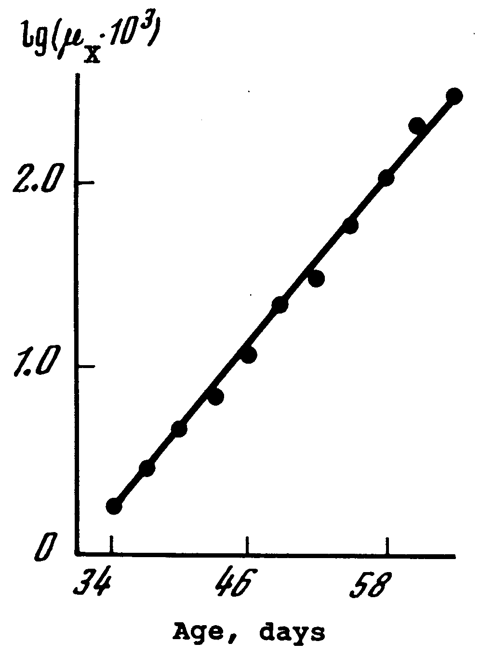

Gompertz Law of Mortality in Fruit Flies
Based on the life table for 2400 females of Drosophila melanogaster published by Hall (1969).
Source: Gavrilov, Gavrilova, “The Biology of Life Span” 1991

Slide 8
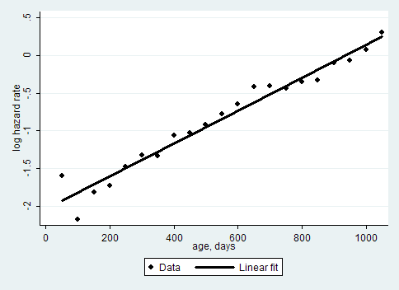
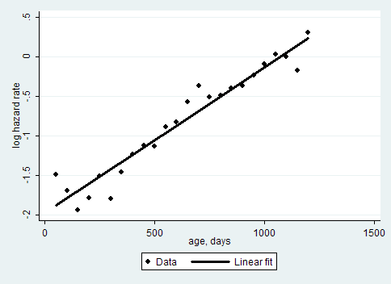

Mortality of Wistar rats
males
females
Actuarial estimate of hazard rate with 50-day age intervals
Data source: Weisner, Sheard, 1935

Slide 9

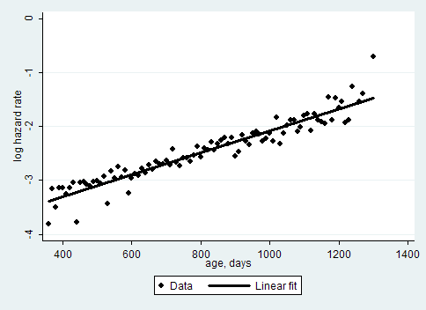
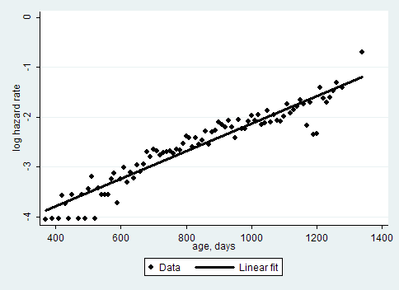
Mortality of mice (log scale)
Miller data
males
females
Actuarial estimate of hazard rate with 10-day age intervals

Slide 10
The Gompertz-Makeham Law
Death rate is a sum of age-independent component (Makeham term) and age-dependent component (Gompertz function), which increases exponentially with age. Important for historical human data.
μ(x) = A + R e ^{αx}
A – Makeham term or background mortality
R e ^{αx} – age-dependent mortality; x - age
risk of death

Slide 11
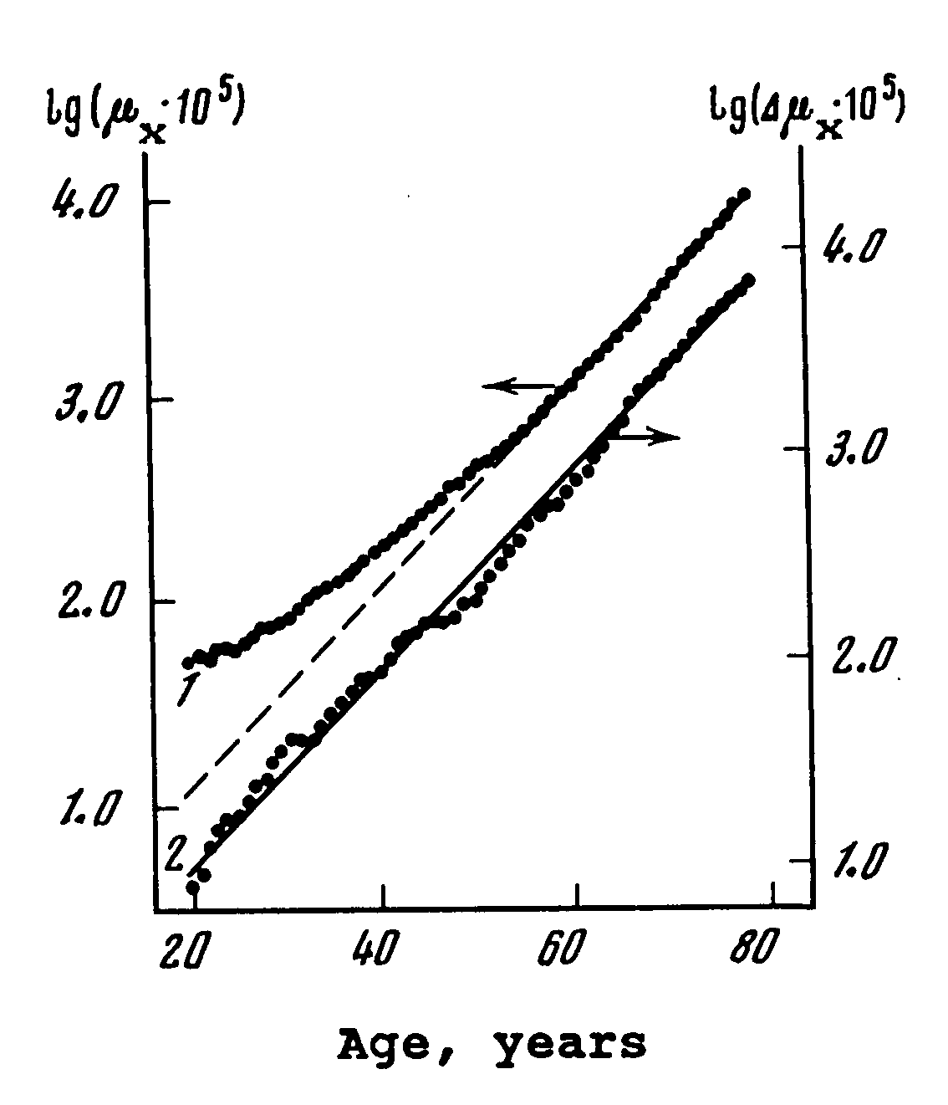

Gompertz-Makeham Law of Mortality in Italian Women
Based on the official Italian period life table for 1964-1967.
Source: Gavrilov, Gavrilova, “The Biology of Life Span” 1991

Slide 12
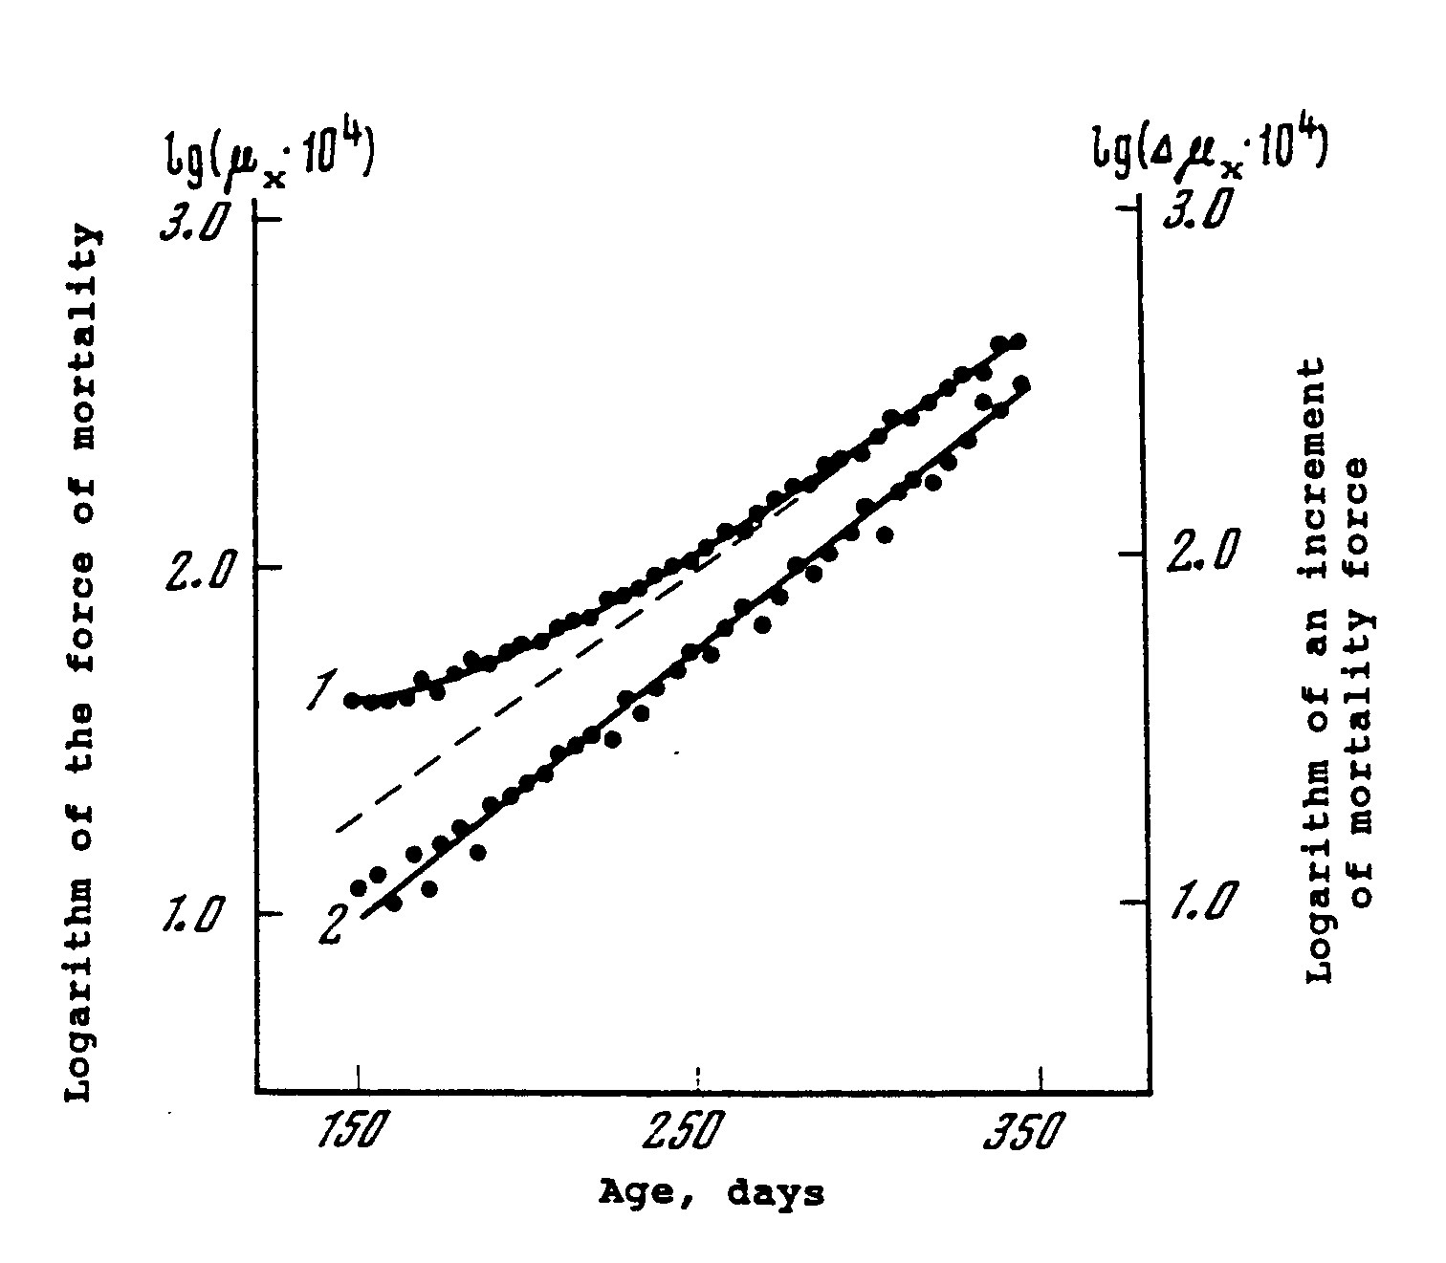

Gompertz-Makeham Law of Mortality in Flour Beetles
Based on the life table for 400 female flour beetles (Tribolium confusum Duval). published by Pearl and Miner (1941).
Source: Gavrilov, Gavrilova, “The Biology of Life Span” 1991

Slide 13
Comparison of Gompertz law with competing Weibull mortality law
Statistical analysis of 290 human populations and 129 life tables of fruit flies revealed that the Gompertz law describes mortality better than competing Weibull law used to fit failure rates of technical systems (Gavrilov, Gavrilova, 1991).

Slide 14
The Strehler-Mildvan Correlation (Science, 1960):
Inverse correlation between the Gompertz parameters
Limitation: Did not take into account the Makeham parameter that leads to spurious correlation.
Our simulation study showed that this correlation was caused by varying values of the Makeham term

Slide 15
The Second Mortality Law: Compensation Law of Mortality
(late-life mortality convergence)
In 1978, we described the phenomenon of the compensation effect of mortality, where Gompertz mortality trajectories tend to converge in semi-logarithmic coordinates around age 95.

Slide 16
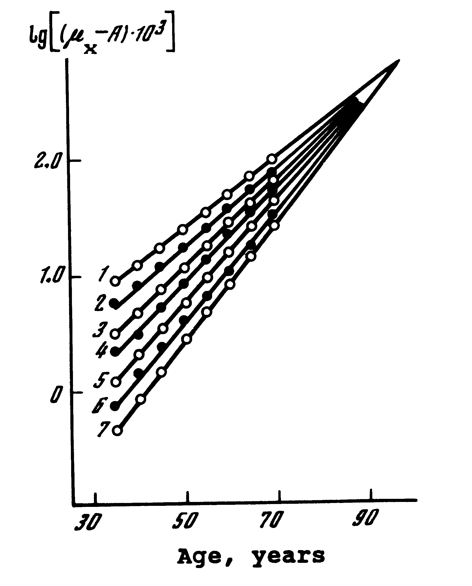
Compensation Law of Mortality
Convergence of Mortality Rates with Age
1 – India, 1941-1950, males
2 – Turkey, 1950-1951, males
3 – Kenya, 1969, males
4 - Northern Ireland, 1950-1952, males
5 - England and Wales, 1930-1932, females
6 - Austria, 1959-1961, females
7 - Norway, 1956-1960, females
Source: Gavrilov, Gavrilova,
“The Biology of Life Span” 1991

Slide 17
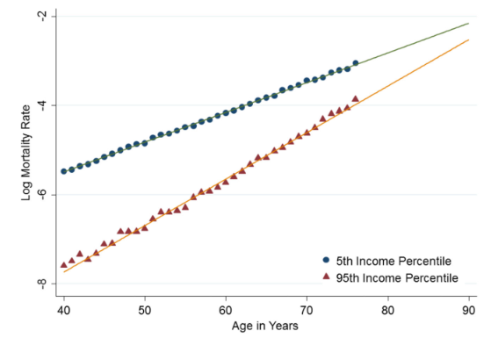
Compensation Law of Mortality
The Association Between Income and mortality of men in the United States, 2001-2014
Source: Chetty et al., JAMA. 2016;315(16):1750-1766. doi:10.1001/jama.2016.4226

Slide 18
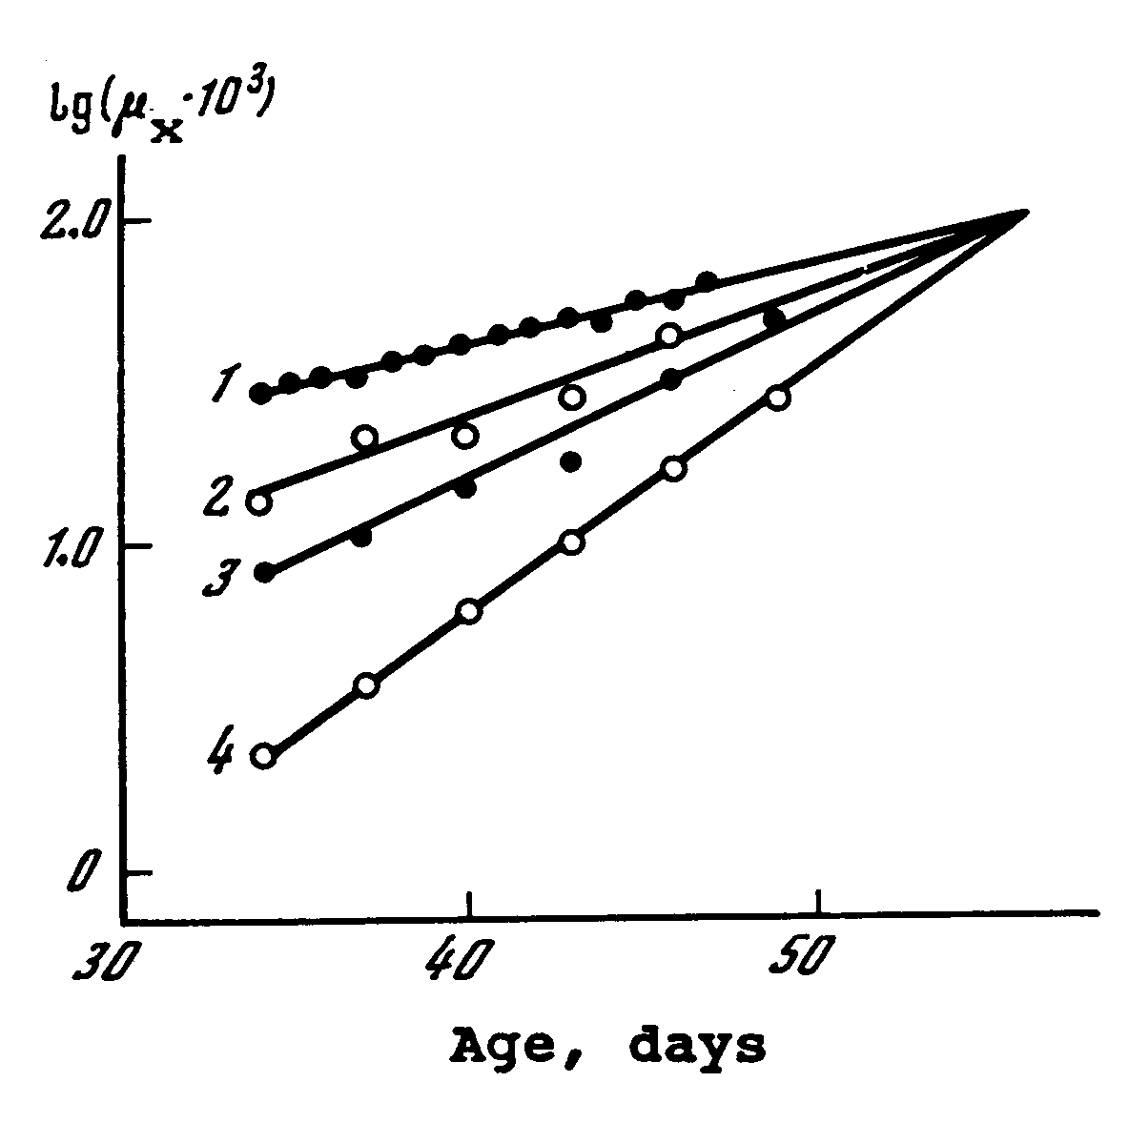
Compensation Law of Mortality in Laboratory Drosophila
1 – drosophila of the Old Falmouth, New Falmouth, Sepia and Eagle Point strains (1,000 virgin females)
2 – drosophila of the Canton-S strain (1,200 males)
3 – drosophila of the Canton-S strain (1,200 females)
4 - drosophila of the Canton-S strain (2,400 virgin females)
Mortality force was calculated for 6-day age intervals.
Source: Gavrilov, Gavrilova,
“The Biology of Life Span” 1991

Slide 19
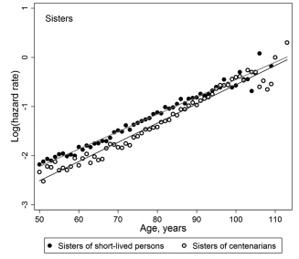
Compensation effect of mortality is a challenge to life extension
Even familial longevity does not help to decrease mortality after age 100 years.
Source: Gavrilova N.S., Gavrilov L.A. Protective Effects of Familial Longevity Decrease With Age and Become Negligible for Centenarians. Journal of Gerontology – Series A, 2022, Vol.77(4): 736-743.

Slide 20
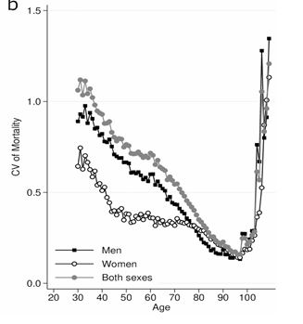
Some researchers challenged this finding, suggesting that the effect was merely an artifact of spurious correlation between biased estimates of Gompertz parameters (Tarkhov, 2017).
However, our recent studies confirmed the existence of the compensation effect, with the convergence point aligning with minimal mortality variation.
The age of convergence point called the species-specific lifespan did not change over the last 50 years and is equal to 95-98 years (Gavrilov et al., 1978, Gavrilov, Gavrilova, 2022, Milevsky, 2020)
Mortality data for 44 human populations.
Data Source: Human Mortality Database
Source: Gavrilova, Gavrilov, Biogerontology, 2024

Slide 21
The Third Mortality Law:
The Late-Life Mortality Deceleration (Mortality Leveling-off, Mortality Plateaus)
In our 1991 book "The Biology of Life Span", we described the phenomenon of late-life mortality deceleration, where mortality rates deviate downwards from the Gompertz law at very advanced ages.

Slide 22
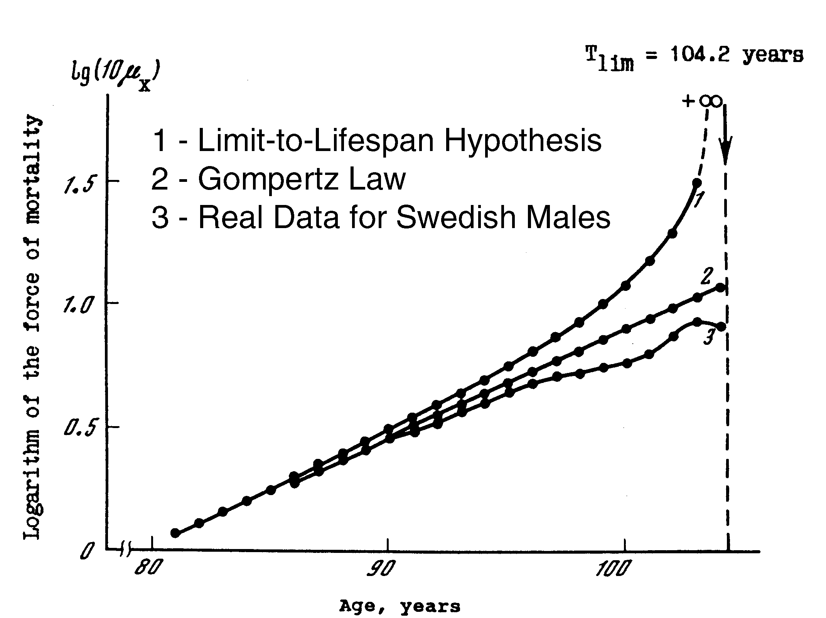
Testing the “Limit-to-Lifespan” Hypothesis
Source: Gavrilov L.A., Gavrilova N.S. 1991. The Biology of Life Span

Slide 23

Mortality Leveling-Off in House Fly
Musca domestica
Based on life table of 4,650 male house flies published by Rockstein & Lieberman, 1959

Slide 24
Studies by demographers after 1991
This concept gained significant attention among demographers in the 1990s. Some demographers believed that they can present mortality deceleration as a kind of their discovery. They published articles on mortality deceleration for insects and humans.
They wrote literally the following: “Mortality deceleration came as a surprise, indeed as a shock, to many biologists and gerontologists…” Between Zeus and the Salmon, 1997, p.25
This is despite extensive publications by gerontologists G. Sacher and A. Economos on mortality deceleration in the 1960s and 1970s.
Earlier studies by actuaries (Perks, Beard) were not cited either.

Slide 25
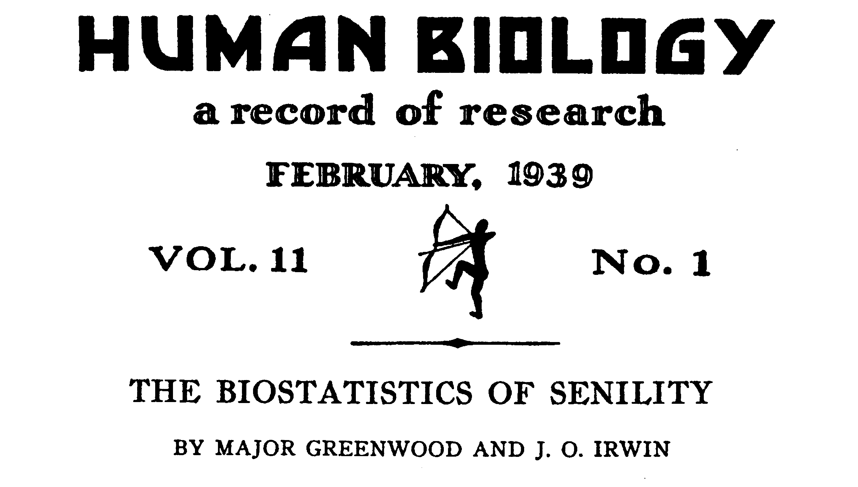
We decided to inform the scientific community at the 2003 International Symposium “Living to 100”

Slide 26
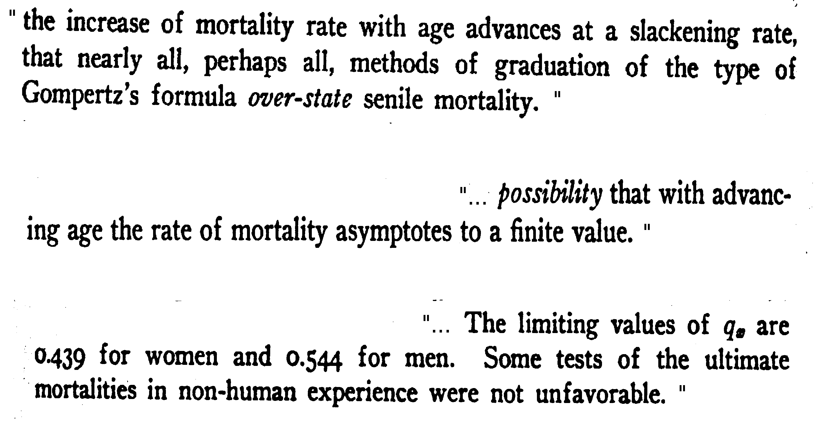
M. Greenwood, J. O. Irwin. BIOSTATISTICS OF SENILITY

Slide 27
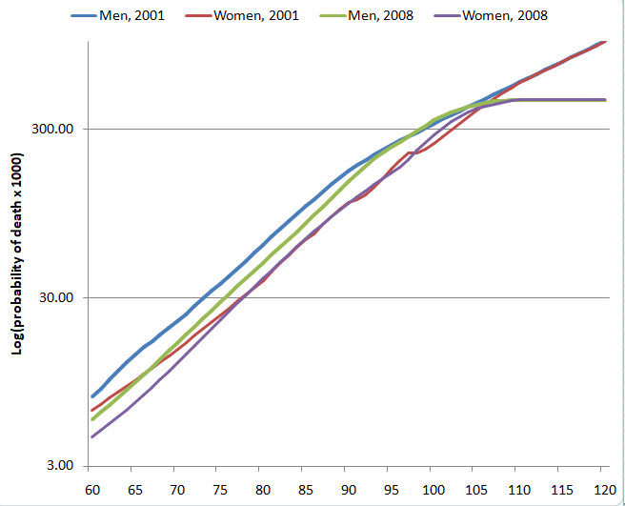
Mortality in Valuation Basic Tables (VBT) for Non-Smokers by the Society of Actuaries
VBT-2001
VBT-2008
VBT tables in 2001 and 2008 show totally different trajectories after age 100 years

Slide 28
Further Developments
A Study of Extinct Birth Cohorts in the United States (2004)
Data from the Social Security Death Index. In 2004 it was publicly available on website. We collected data using web fetching technique
Later the last complete version of SSA Death Master File was officially obtained from the U.S. National Technical Information Service (NTIS)

Slide 29
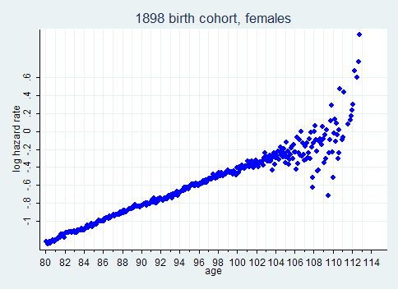
Birth cohort mortality, SSA Death Master File (DMF) data
Where is Mortality Deceleration?
Nelson-Aalen monthly estimates of hazard rates using Stata 11

Slide 30
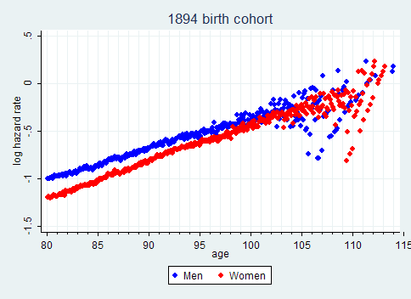
Mortality of men and women converge at very old age

Slide 31
Gompertz model of old-age mortality
Study of 20 single-year extinct U.S. birth cohorts based on the Social Security Administration Death Master File (DMF) found no mortality deceleration up to ages 105-106 years (Gavrilova, Gavrilov, 2011).
However, data quality problems did not allow us to study mortality trajectories after age 107 or 110 years using this source of data.

Slide 32
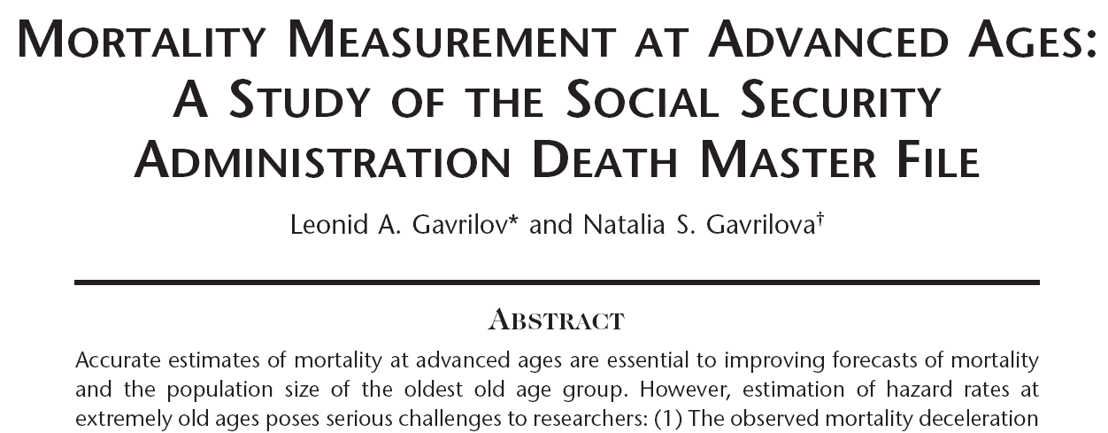
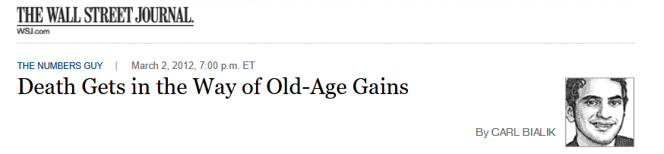
North American Actuarial Journal, 2011, 15(3):432-447
Featured in the Wall Street Journal:

Slide 33
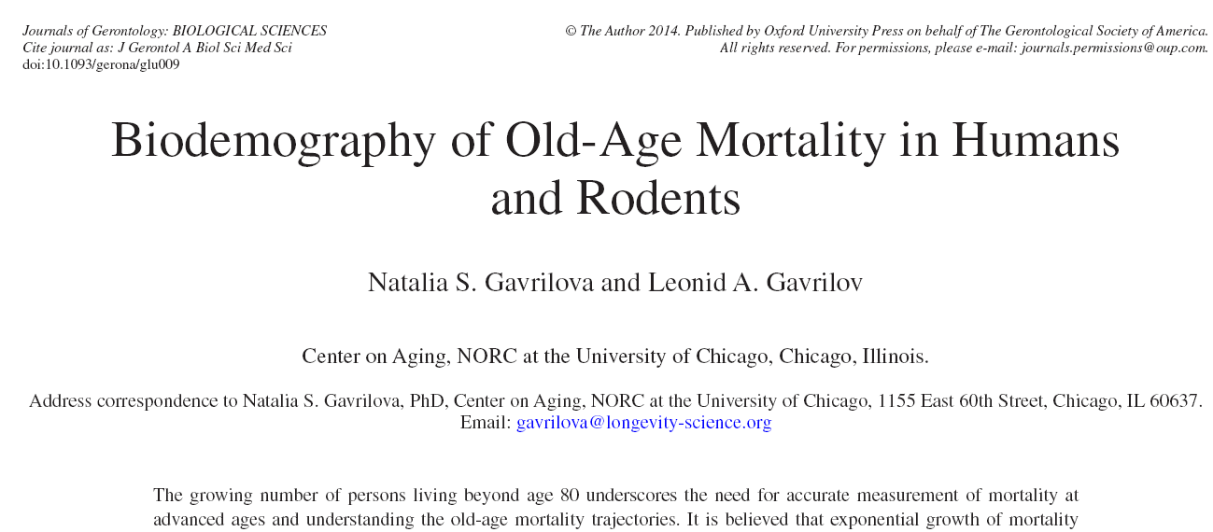
The second studied dataset:
U.S. cohort death rates taken from the Human Mortality Database, our 2014 study

Slide 34
Problem of mortality estimation at older ages
Age misreporting
Study by Preston group found that age misreporting results in spurious mortality deceleration

Slide 35
Hypothesis
Mortality deceleration at advanced ages among old DMF cohorts (born before 1886) may be caused by poor data quality (age exaggeration) at very advanced ages
If this hypothesis is correct then mortality deceleration at advanced ages should be less expressed for data with better quality

Slide 36
What is the quality of age reporting in SSA Death Master File across ages and birth cohorts?
Our 2018 study of data quality for five single-year birth cohorts
Supported by the Society of Actuaries

Slide 37
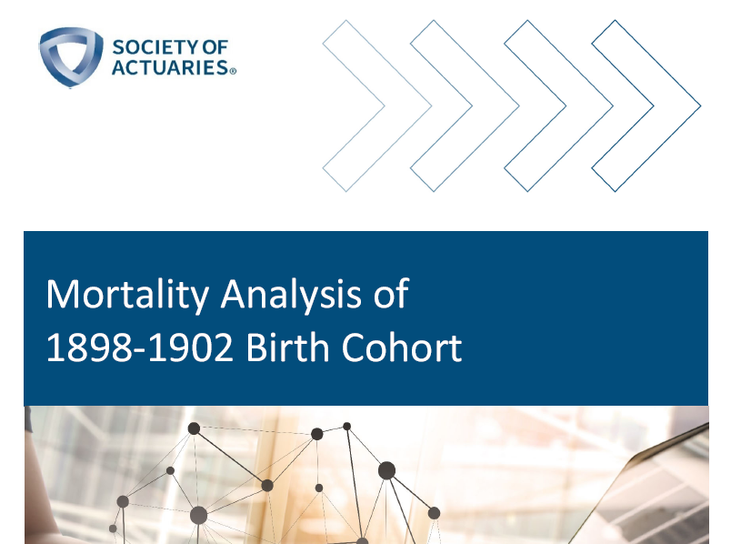
More details are available in a special report by the SOA
Supported by the Society of Actuaries

Slide 38
Study Design
Five single-year birth cohorts:
1898, 1899, 1900, 1901, 1902
Direct age validation of DMF samples randomly selected at ages 100, 103, 105 and 109+ years
Sample sizes: 100 records for ages 100-105 years
For age group 109+ years – all records

Slide 39
Age validation procedure
Age validation was conducted by linkage of DMF records to early historical sources (U.S. censuses, birth and marriage records, draft registration cards).
DMF records were scored according to reliability of age reporting. The scoring system included the following scores:
1 – several early historical sources agree about birth date
2 – one early historical sources agrees about birth date
3 – later sources agree about birth date
4 – early sources disagree
5 – foreign-born individual arrived in the U.S. later in life
6 – not found in any sources

Slide 40
Percent of records with questionable quality as a function of age. 1898, 1900 and 1902 birth cohorts
Results of age validation study for samples of 100 records, by age group.
For ages 109 and 110+ years sample sizes were slightly higher than 100.

Slide 41
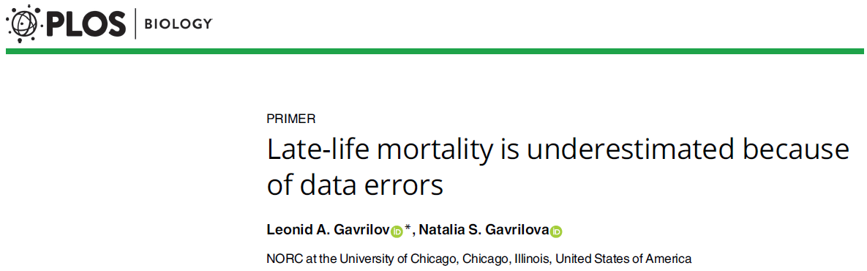
Further development
Direct age validation of all records at ages 105 and over for those born in 1900, our 2019 study

Slide 42
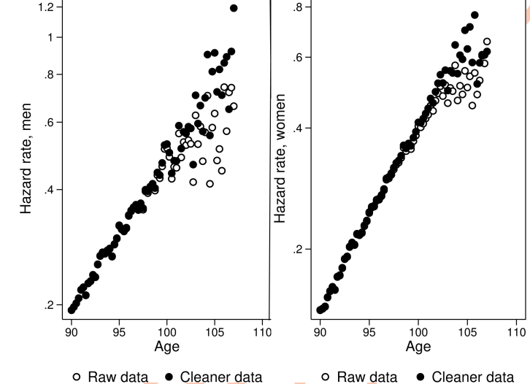
Mortality of U.S. men (left) and women (right) born in 1900 before and after data cleaning
Source: Gavrilov, Gavrilova, PLOS Biology, 2019.
Data: 1900 DMF birth cohort cleaned after age 104 years of age using linkage to historical documents

Slide 43
Conclusion:
Age misreporting produces spurious mortality deceleration

Slide 44
Hypothesis
Mortality deceleration at advanced ages may be caused by poor data quality (age exaggeration) at very advanced ages
If this hypothesis is correct then mortality deceleration should be more prevalent among historically older birth cohorts

Slide 45
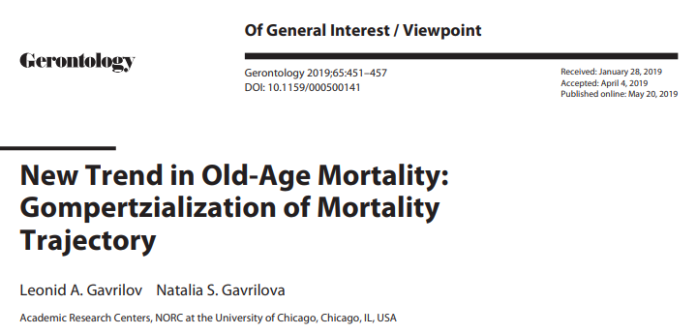
In 2019 we found a new trend in old-age mortality using U.S. cohort data: Transition from mortality deceleration to the Gompertz trajectory

Slide 46
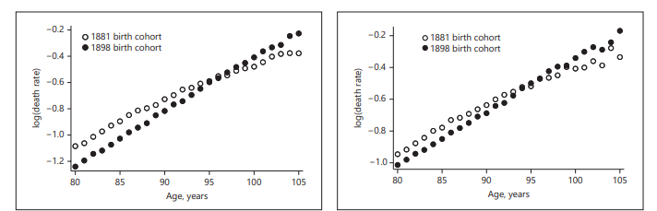
Transition to the Gompertz model
Mortality of U.S. women (left) and men (right) in earlier and later birth cohorts
Source: Gavrilov, Gavrilova, New Trend in Old-Age Mortality: Gompertzialization of Mortality Trajectory, Gerontology, 2019.

Slide 47
Is this trend observed in other countries?
We analyzed mortality for nine countries with relatively large populations in order to have sufficient number of survivors beyond age 100: Australia, Belgium, Canada, France, Italy, Japan, Spain, United Kingdom and USA.
For all nine studied countries we analyze mortality of 1880-1902 single-year birth cohorts for men and women separately

Slide 48
Methods
We fit mortality for two competing models: the Gompertz model and the Kannisto (mortality deceleration) model using weighted non-linear regression method in the age interval 80-105 years (nlin procedure in Stata). Values of exposure were used as weights.
Akaike Information Criterion (AIC) is used to evaluate goodness of fit for the Gompertz and the Kannisto models

Slide 49
Gompertzialization:
Transition from mortality deceleration to the Gompertz model
Best models according to AIC differences for 1880-1902 birth cohorts, by country
Comparison of Gompertz (G) and Kannisto (K) models. U – uncertain result (|ΔAIC| < 5)
Country | Sex | 1880 | 1881 | 1882 | 1883 | 1884 | 1885 | 1886 | 1887 | 1888 | 1889 | 1890 | 1891 | 1892 | 1893 | 1894 | 1895 | 1896 | 1897 | 1898 | 1899 | 1900 | 1901 | 1902
USA | M | K | K | K | K | K | K | U | U | G | G | G | G | G | G | G | G | G | G | G | G | G | G | G
 | F | K | K | K | K | K | K | U | G | G | G | G | G | G | G | G | G | G | G | G | G | G | G | G
UK | M | U | U | K | K | K | K | K | K | K | K | K | U | G | G | G | G | G | G | G | G | G | G | G
 | F | K | K | K | K | K | K | K | K | K | K | K | K | K | K | G | G | G | G | G | G | G | G | G
Canada | M | K | K | K | K | K | K | G | K | U | U | U | G | G | G | G | G | G | G | G | G | G | G | G
 | F | K | K | K | K | K | K | K | U | G | G | G | G | G | G | G | G | G | G | G | U | U | G | U
Fitting age-specific cohort death rates taken from the Human Mortality Database

Slide 50
Transition from mortality deceleration to the Gompertz model
1880-1902 UK birth cohorts.
AIC values for fitting Gompertz and Kannisto models
Fitting age-specific cohort death rates taken from the Human Mortality Database

Slide 51
No transition to the Gompertz model
1880-1902 Japanese birth cohorts.
AIC values for fitting Gompertz and Kannisto models
Fitting age-specific cohort death rates taken from the Human Mortality Database

Slide 52
Transition to uncertain model in women
1880-1902 Italian birth cohorts.
AIC values for fitting Gompertz and Kannisto models
Fitting age-specific cohort death rates taken from the Human Mortality Database

Slide 53
Summary of Results (presented at the 2023 SOA Living to 100 Symposium)
Mortality transition pattern | Men | Women
From mortality deceleration to the Gompertz model | Australia, Belgium, Canada, France, Italy, UK, USA | Belgium, UK, USA
From mortality deceleration to uncertain pattern | Spain | Australia, Canada, France, Italy
Mortality deceleration for all studied birth cohorts | Japan | Japan, Spain

Slide 54
Conclusion
These findings reaffirm the enduring relevance of the Gompertz law as a fundamental tool for describing mortality patterns, even at the most advanced ages.

Slide 55


Thank you for your attention!
29

